Slide 1
Week 1

Slide 2
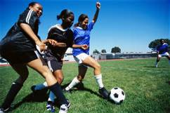
Math Corner-Monday
Christy’s soccer team has seven six packs of Gatorade to drink. How many bottles of Gatorade do they have in all?
Solve this problem using BOTH multiplication and addition.

Slide 3

Math Corner-Tuesday
Solve this problem two different ways. Use pictures, numbers, and words.
1. How many legs are there on nine birds and seven dogs?
2. How many more legs would be needed to equal 100?

Slide 4

Math Corner-Wednesday
Ms. Freeman is buying cookies for her class.
She has 18 children and wants each child to receive 3 cookies.
How many cookies does she need to buy?
Explain your thinking using pictures, numbers, and words.

Slide 5
Math Corner-Thursday
Lane collects stamps in an album. Eight stamps can fit on a page. So far, she has four pages filled.
How many stamps does Lane have in her collection? Can you solve the problem two different ways?
Her goal is to collect 100 stamps. How many more stamps does she need to collect to reach her goal?

Slide 6
Math Corner-Friday
At Mike’s farm, there are six pigs, three ducks, two chickens, and one sheep.
Create a table and pictograph for this data. On your pictograph, each picture should represent two legs.
2. How many legs are at Mike’s farm? Solve this problem two ways.

Slide 7
Week 2

Slide 8
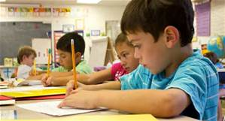
Math Corner-Monday
Write a story problem where you could use the array model to find the product of 5 x 9. Solve it using a number line and repeated addition.

Slide 9
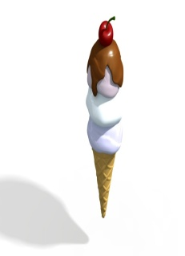
Math Corner-Tuesday
Mrs. Johnson’s class won an ice cream party for perfect attendance. Each student will get a triple scoop ice cream at the party. There are 10 students in Mrs. Johnson’s class. How many scoops will it take for the class to get their triple scoop ice cream?
Use two strategies to prove your thinking.

Slide 10
Math Corner-Wednesday
At the Fall Festival, Donna is polishing finger nails. So far, she has polished eight hands. How many FINGERNAILS has she polished so far? Solve your problem two different ways.

Slide 11
Math Corner-Thursday
There are 48 legs on the farm. How many cows are there? Solve this problem two different ways.

Slide 12
Math Corner-Friday
There are 33 eyes on the space ship. How many three eyed aliens are there?
Show your thinking using pictures, numbers, and words.

Slide 13
Let’s Review!
Read each question carefully and choose the best answer choice.
You must show your math thinking for each question.
You have 10 minutes, so use your time wisely.

Slide 14
Nick had some baseball cards. He gave 9 of them to Owen. How many baseball cards did Nick start with? 3 18 36 243 | 2. Pam, Sela, and Yuri each sold 21 tickets to the play. Which number sentence show how many tickets the 3 friends sold in all? 3 x 21 = 63 3 + 21 = 24 21 – 3 = 18 21 ÷ 2 = 7 | 3. There are 12 tables in the room. Each table has 6 chairs. Which number sentence shows the total number of chairs at the tables? 12 – 6 = 6 12 + 6 = 18 12 ÷ 6 = 2 12 x 6 = 72 | 4. There are 32 people in line for the roller coaster. There are 8 people in line for the fun house. How many fewer people are in line for the fun house than are in line for the roller coaster? 256 40 24 4
Free Response: John opened a crate. He took 28 bottles from the crate and put them on the shelf. There were 7 bottles left in the crate. How many bottles were in the crate before John opened it?

Slide 15
Week 3

Slide 16
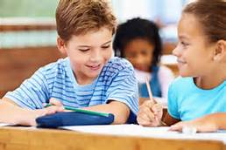
Math Corner-Monday
Write a story problem about the following expression and solve in different ways.
4 x 50

Slide 17
Math Corner-Tuesday
Write a story problem about the following expression and solve in different ways.
9 x 80

Slide 18
Math Corner-Wednesday
Solve with pictures and numbers. There are 41 doughnuts. Eight friends will share the doughnuts equally. How many doughnuts will each friend get? What else do you notice?
Challenge! Can you solve it one more way?

Slide 19
Math Corner-Thursday
The magic number is:
45
Figure out a way to reach this product using:
Repeated addition
Array models
Skip counting
Equal grouping

Slide 20
Math Corner-Friday
The magic number is:
36
Figure out a way to reach this product using:
Repeated addition
Array models
Skip counting
Equal grouping

Slide 21
Let’s Review!
Read each question carefully and choose the best answer choice.
You must show your math thinking for each question.
You have 10 minutes, so use your time wisely.

Slide 22
There are 9 students in the computer lab. There are 36 students in the library. How many more students are there in the library than in the computer lab? 4 27 45 324 | 2. Meg had 34 red beads. She had 17 green beads. Then, Meg gave 12 of her beads to Ava. How many beads does Meg have left? 63 41 39 5 | 3. A package of toy bugs has 6 spiders and 2 beetles. Ted bought 7 packages. How many bugs does Ted have? 28 42 56 84 | 4. Mandy needs 40 cards to make invitations for the party. She has 4 packages of cards. Each package has 8 cards. How many more cards does Mandy need? 52 32 8 2
Free Response: Let’s figure our how many chairs there are in the school auditorium. Each row has 16 chairs. There are 8 rows. How many chairs are there in the auditorium? Solve this problem two different ways.

Slide 23
Week 4

Slide 24
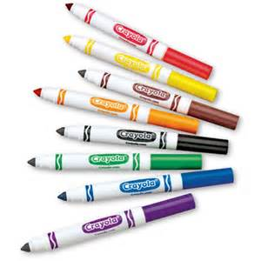
Math Corner-Monday
Corey, Jamal, and Austin have nine markers each. How many markers do they have combined? How many more will they need to have 100 markers?
.

Slide 25
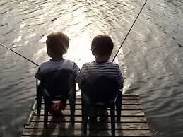
Math Corner-Tuesday
Peter goes fishing with Danny. Danny catches 4 big fish and 4 small fish. Peter catches six times as many fish as Danny.
How many fish did Peter catch?
Solve using at least 2 different strategies.

Slide 26
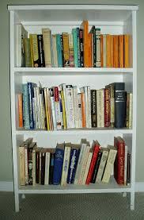
Math Corner-Wednesday
Ivan is putting books in his bookcase. He had already put 74 books in the bookcase but he has 225 books in all. How many more books does he have to put in the bookcase?
Challenge! Can you solve it one more way?

Slide 27
Math Corner-Thursday
The magic number is:
48
Figure out a way to reach this product using repeated addition.
Figure out a way to reach this QUOTIENT using repeated subtraction.

Slide 28
Math Corner-Friday
The magic number is:
36
Figure out a way to reach this product using repeated addition.
Figure out a way to reach this QUOTIENT using repeated subtraction.

